Slide 1
Hypothyroidism With Pregnancy
Presented by
Sara kasem Abd El Aal
Assistant Lecturer of Internal Medicine
Sohag Faculty of Medicine – Sohag University

Slide 2
Outline
Physiologic adaptation during pregnancy
Thyroid function tests
Screening for thyroid dysfunction during or before pregnancy
Hypothyroidism management during pregnancy

Slide 3
Physiologic adaptation during pregnancy
To meet the increased metabolic needs during a normal pregnancy , there are changes in thyroid physiology that are reflected in altered thyroid function tests .
The major changes in thyroid function during pregnancy are an increase in serum thyroxin binding globulin (TBG) concentration ,and stimulation of the thyrotopin (TSH)receptor by human chorionic gonadotropin hcg

Slide 4
Increase in thyroxin binding globulin
-secondary to estrogenic stimulation of TBG synthesis and reduced hepatic clearance of TBG .two to three fold.
-levels of bound proteins ,total thyroxin ,total triiodothyronine are increased.
-begin early in the first trimester ,plateaus during midgestation ,and persist until shortly after delivery .

Slide 5
Human chorionic gonadotropin (hcg):
- Similarity of TSH and hcg
-HCG has weak thyrotropic activity stimulates TSH receptor
-serum hcg concentrations increase soon after fertilization ,peaks around gestational week 10-12 during this peak ,total serum T4and T3 concentrations increase , serum free T4 and T3 concentrations increase slightly , usually within the normal range , and serum TSH concentrations are appropriately reduced ,decline to undetectable level at gestational week 20

Slide 6
- Later in pregnancy , as hcg secretion declines ,serum free T4and T3 concentration decline and serum TSH concentration rise slightly to or within normal range.
- 20% increase in size of the gland due to hyperplasia and vascularity

Slide 7
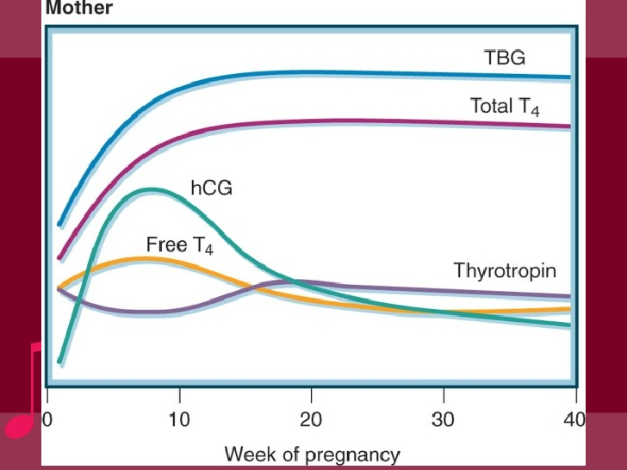

Slide 8
Iodine requirements :
Iodine requirements are higher in pregnant than non pregnant women due to :
-increase in maternal T4 production required to maintain maternal euthyroidism
-increase renal iodine clearance
All pregnant women should ingest approximately 250mcg iodine daily ,strategies may need to be varied based on country of origin .(s-H)
ATA Releases New Guidelines on Thyroid Disease in Pregnancy
Veronica Hackethal, MD
January 12, 2017

Slide 9
Thyroid function in the fetus
During the 10-12 week of gestation ,fetal TSH appears and the fetal thyroid capable of concentrating iodine and synthesizing iodothyronines , however , little hormone synthesis occur until the 18-20 week , thereafter , fetal thyroid secretion increase gradually
Placental transfer of maternal T4,T3 is believed to occur prior to fetal thyroid hormones synthesis and continue thereafter

Slide 10
May be the only source of thyroid hormone during early fetal life , and it is important to maintain normal maternal thyroid status for brain maturation of developing fetus

Slide 11
Thyroid function testing and pregnancy
When possible , population based trimester –specific reference ranges for serum thyroid stimulating hormone (TSH) should be defined through assessment of local population data representative of a healthcare providers practice reference range determinations should only include pregnant women with no known thyroid disease , optimal iodine intake and negative auto antibodies to thyroid peroxidase (TPOAb) status (S-M)
ATA Releases New Guidelines on Thyroid Disease in Pregnancy
Veronica Hackethal, MD
January 12, 2017

Slide 12
Results of TSH, fT₃, and fT₄ in the study group in consecutive trimesters of pregnancy
Lower and upper limits of the reference intervals (2.5 and 97.5 percentiles) are provided with 90% confidence intervals.
3rd trimester (n=172) | 2nd trimester (n=172) | 1st trimester (n=172)
0.11(0.03-0.11) 3.53(2.94-3.94) | 0.05(0.01-0.11) 3.44(3.05-3.77) | 0.09(0.008-0.010) 3.18(2.96-3.83) | TSH mIU/L
3.10(2.92-3.26) 5.37(5.04-5.55) | 3.29(3.16-3.41) 5.45(5.20-5.64) | 3.63(3.43-3.71) 6.55(6.23-6.84) | Ft3,pmol/L
8.69(8.63-9.62) 17.23(16.20-18.32) | 10.46(10.34-10.67) 16.76(16.03-17.20) | 11.99(11.52-12.15) 21.89(20.84-23.92) | Ft4 , pmol/L
PMC full text:Eur Thyroid J. 2017 Apr; 6(2): 82–88.Published online 2017 Feb 3. doi: 10.1159/000453061
Copyright/License ►Request permission to reuse

Slide 13
Thyroid auto antibodies
Antithyroid antibody studies are used to evaluate for autoimmune thyroid problems.
Antibodies directed against 3 major thyroid antigens are as follows:
Thyroglobulin: Antithyroglobulin antibody (TgAb)
Thyroid peroxidase (microsomal antigen): Antithyroid peroxidase antibody (TPOAb)

Slide 14
TSH receptor: Anti-TSH receptor antibody
Anti-TPO or anti-Tg thyroid autoantibodies are present in 2% to 17% of unselected pregnant women
ShiX, HanC, LiC, MaoJ, 2015 Optimal and safe upper limits of iodine intake for early pregnancy in iodine-sufficient regions: a cross-sectional study of 7,190 pregnant women in China. J Clin Endocrinol Metab 100:1630–1638

Slide 15
Screening for thyroid dysfunction before or during pregnancy
All pregnant women should be verbally screened at the initial prenatal visit for any history of thyroid dysfunction ,and prior or current use of either thyroid hormone ( LT4) or antithyroid medications(methimazole(MMI) ,carbimazole(CM) or proppylthiouracil(PTU) . (S-H)

Slide 16
All patients seeking pregnancy , or newly pregnant , should undergo clinical evaluation , if any of the following risk factors are identified testing for serum TSH is recommended (S-M)
1- a history of hypothyroidism /hyperthyroidism or current symptoms/signs of thyroid dysfunction
2- known thyroid antibody positivity or presence of goiter
ATA Releases New Guidelines on Thyroid Disease in Pregnancy
Veronica Hackethal, MD
January 12, 2017

Slide 17
3- history of head or neck radiation or prior thyroid surgery .
4-age >30 years
5-type I diabetes or other autoimmune disorders
6- history of pregnancy loss , preterm delivery or infertility
7- family history of autoimmune thyroid disease or thyroid dysfunction

Slide 18
8-morbid obesity (BMI>40 kg/m2)
9-use of amiodarone or lithium or recent administration of iodinated radiologic contrast
10-residing in an area of known moderate to sever iodine deficiency

Slide 19
Hypothyroidism during pregnancy
maternal hypothyroidism is defined as a TSH elevated beyond the upper limit of the pregnancy specific reference range(S-H)
Subclinical
Overt hypothyroidism
Normal Free T4 Estimate
TSH usually below 10 mu/l
5% or more USA
Low Free T4 Estimate
TSH usually above 10 mu\l
Less than 1% USA

Slide 20
Hypothyroidism in pregnancy
Causes:
Hashimotos thyroiditis 80%
Prior radioactive iodine treatment
Surgical ablation of graves disease
Overtreatment of hyperthyroidism with thionamides
Iodine deficiency
Postpartum thyroiditis
pituitary or hypothalamic disease

Slide 21
Diagnosis
Symptoms masked by the hypermetabolic state of pregnancy
20-30% overt hypothyroidism develops symptoms :
Weight gain
Lethargy, decrease in exercise capacity
Intolerance to cold
Constipation ,hoarseness of voice
Hair loss, brittle nail, dry skin
Delay in relaxation phase of deep tendon reflexes

Slide 22
Pregnancy outcome
Overt maternal hypothyroidism has consistently been associated with an increase risk of adverse pregnancy complications :
Maternal complications:
Pregnancy loss
Preeclamsia, eclamsia , gestational hypertension
Increased use of cesarean section because of fetal distress
Placental abruption
Postpartum hemorrhage

Slide 23
Fetal complications:
stillbirth
Premature birth
Low birth weight
Low offspring IQ
De Groot LJ, Abalovich M, Alexander EK et al. Management of thyroid dysfunction during pregnancy and postpartum: an endocrine society clinical practice guideline. J. Clin. Endocrinol. Metab. 97(8), 2543–2565 (2016)

Slide 24
ATA GUIDELINES for clinical management of hypothyroidism during pregnancey 2017
Ttt of overt hypothyroidism is recommended during pregnancy(S-M)
pregnant women with TSH>2.5mU/L should be evaluated for TPOAb status

Slide 25
Subclinical hypothyroidism in pregnancy should be approached as follows:
A-LT4 therapy is recommended for:
TPOAb-positive women with a TSH greater than the pregnancy specific reference range (S-M)
TPOAb-negative women with TSH >10mU/L(S-L)

Slide 26
b- LT4 therapy may be considered for :
TPOAB-positive women with TSH concentration >2.5mU/L, and below the upper limit of the pregnancy reference range (W-M)
TPOAB-negative women with TSH concentration greater than the pregnancy specific reference range and below 10mU/L (W-L)

Slide 27
The recommended treatment of maternal hypothyroidism is administration of oral LT4, other thyroid preparation such as T3 should NOT be used in pregnancy (S-L)
In parallel to treatment of hypothyroidism in a general population ,it is reasonable to target a TSH in the lower half of the trimester specific reference range ,when this is not available ,it is reasonable to target maternal TSH concentration <2.5mU/L(W-M)

Slide 28
Women with overt and subclinical hypothyroidism (treated or untreated), or those at risk of hypothyroidism (e.g. patients who are euthyroid but TPOAb-positive ,post hemithyroidectomy ,or treated with radioactive iodine ) should be monitored with a serum TSH measurement approximately every 4 weeks until mid gestation and at least once near 30 weeks gestation (S-H)

Slide 29
Women diagnosed with SCH during pregnancy with negative TPOAb usually discontinue
levothyroxine after delivery and have thyroid function checked 6 weeks, 6 month and 1 year respectively after delivery to ascertain the continuing requirement for levothyroxine therapy.

Slide 30
But SCH with positive anti TPO antibody required thyroid function test in regular interval as these patients were increased risk for overt hypothyroidism.
Women with TPOAb and TSH greater than 5 mU/l in pregnancy were more likely to have persistently elevated TSH.

Slide 31
Treated hypothyroid women of reproductive age should be counseled regarding the likelihood of increase demand for LT4 during pregnancy such women should also be counseled to contact her caregiver immediately upon a confirmed or suspected pregnancy (S-H)
In hypothyroid women treated with LT4 who are planning pregnancy serum TSH should be evaluated preconception, and LT4 dose adjusted to achieve a TSH value between the lower reference limit and 2.5mU/L(S-M

Slide 32
Following delivery ,LT4 should be reduced to the patient's preconception dose .
additionally thyroid function testing should be performed at approximately 6 weeks postpartum (S-M)
Levothyroxin ingestion should be separated from prenatal vitamins containing iron and calcium supplements ,soya product , at least 4 hours to ensure adequate absorption

Slide 33
In high risk women, check TSH as soon as pregnancy confirmed , with reflex TPOAb if TSH 2.5-10 mu/l
TSH 2.5-10 mu/l
TSH>10 mu/l
Treat with LT4
TPoAb positive
TPoAb negative
TSH
2.5-ULRR
TSH
2.5-ULRR
TSH
ULRR -10 mu/l
TSH
ULRR- 10 mu/l
No TTT
Consider ttt
Consider ttt with LT4
Ttt with LT4

Slide 34
Thank you

